Slide 1
Chongqing University of Technology
ATAI
Advanced Technique of Artificial Intelligence
Chongqing University of Technology
PROP: Pre-training with Representative Words Prediction for Ad-hoc Retrieval （2021_WSDM）
Xinyu Ma, Jiafeng Guo, Ruqing Zhang, Yixing Fan, Xiang Ji and Xueqi Cheng
CAS Key Lab of Network Data Science and Technology, Institute of Computing Technology,
Chinese Academy of Sciences, Beijing, China
University of Chinese Academy of Sciences, Beijing, China
{maxinyu17g,guojiafeng,zhangruqing,fanyixing,jixiang19s,cxq}@ict.ac.cn
Code : https://github.com/Albert-Ma/PROP
2021.04.26 • Chong Qing
Reported by Lele Duan

Slide 2
Chongqing University of Technology
ATAI
Advanced Technique of Artificial Intelligence
Chongqing University of Technology
1. Introduction
2. Experiments
3. Conclusion

Slide 3
Introduction
BERT have shown great success when fine-tuned on information retrieval (IR).
However, pre-training objectives tailored for ad-hoc retrieval have not been well explored.
Existing work has demonstrated that using a pre-training objective that more closely resembles the downstream task leads to better performance.

Slide 4
Methods
Assumption：The query is generated as the piece of text representative of the “ideal” document.
Pre-training task : The representative words prediction (ROP) task.
Pseudo Query
sampling
Word set A
Document
with document language model
Word set B
Pre-training
Transformer
PROP
with ROP(by Pseudo Query) & MLM objective

Slide 5
Methods
Representative Word Sets Sampling
Simulating the varied query length in practice : sampling a positive integer $l$.
Sampling a pair of word sets $S1$ and $S2$ with the same size $l$ in parallel according to the document language model.
Computing the likelihood of each set.

Slide 6
Methods
Representative Words Prediction (ROP).
The word set 𝑆 and the document 𝐷 are concatenated：
=$MLP$（ ）
Suppose set $S1$ has a higher likelihood score than $S2 ，$ROP task can then be formulated by a typical pairwise loss:
Masked Language Modeling (MLM).
BERT: Pre-training of Deep Bidirectional Transformers for
Language Understanding

Slide 7
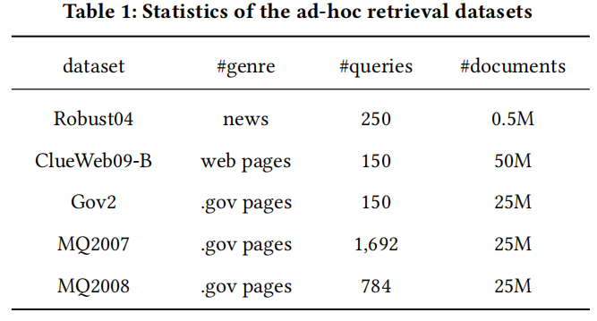
Experiments
Datasets
Pre-training Corpus:
PROPWikipedia
English Wikipedia
MS MARCO Document Ranking dataset
PROPMSMARCO.
Downstream Dataset:

Slide 8
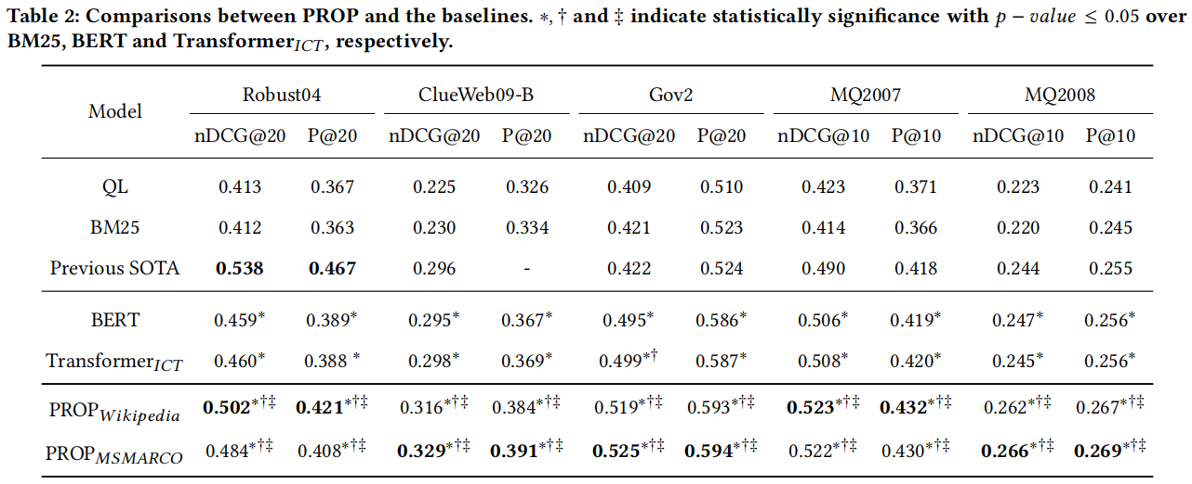
Experiments
HiNT
CEDR-KNRM
NWT
HiNT
BERT-maxP

Slide 9
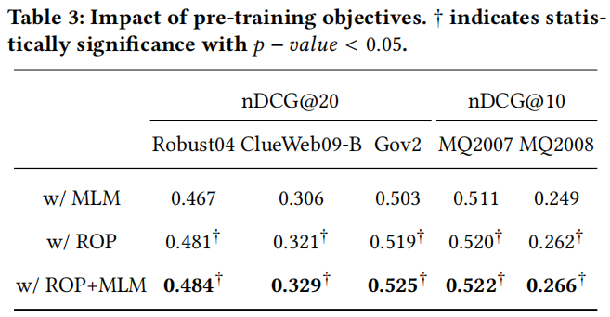
Experiments

Slide 10
Experiments

Slide 11
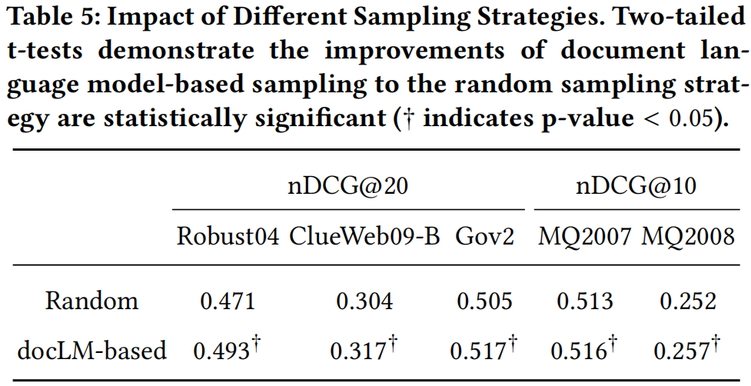
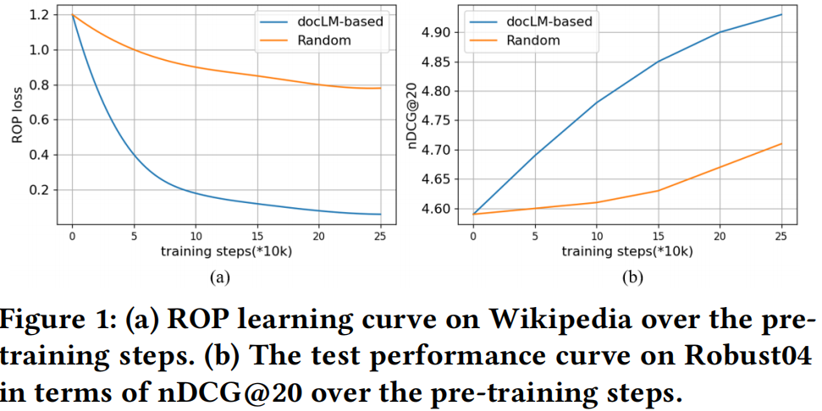
Experiments

Slide 12
Experiments

Slide 13
Conclusion
In this paper, we have proposed PROP, a new pre-training method tailed for ad-hoc retrieval.
The key idea is to pre-train the Transformer model to predict the pairwise preference between the two sets of words given a document, jointly with the MLM objective.

Slide 14
Thanks!

